Slide 1


Slide 2


Slide 3
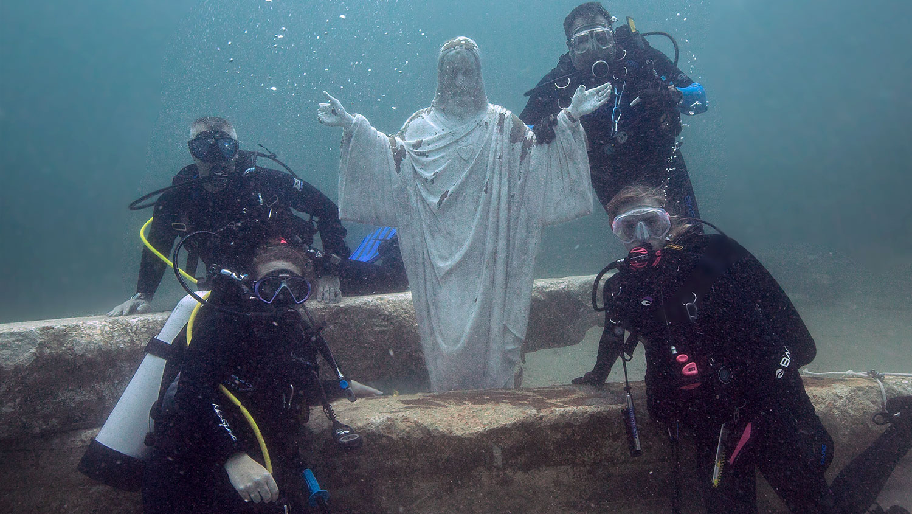

Slide 4
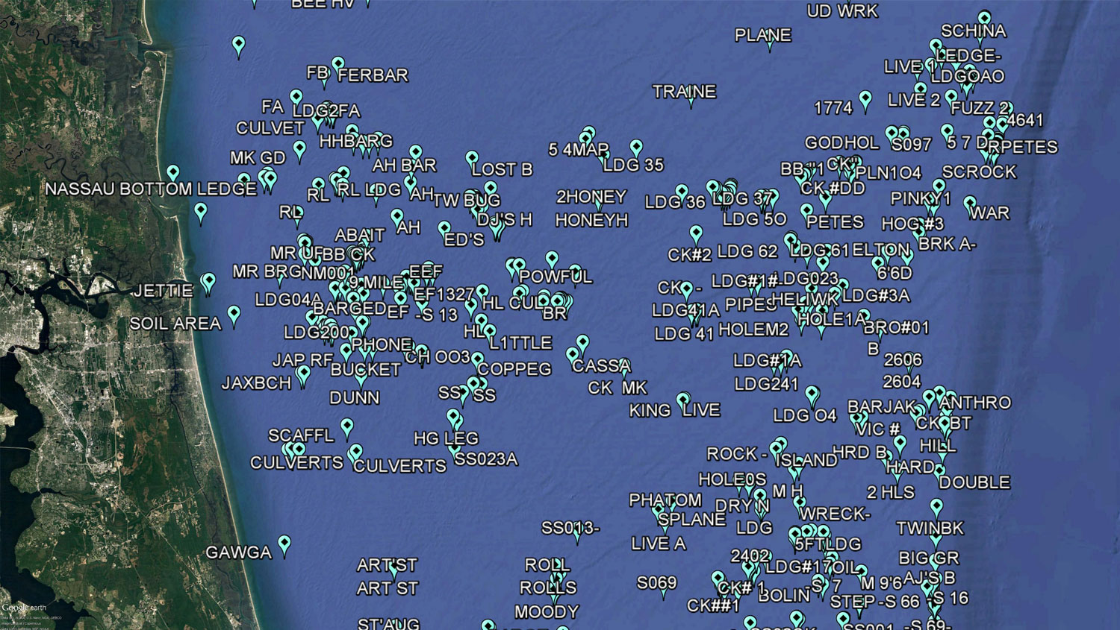

Slide 5
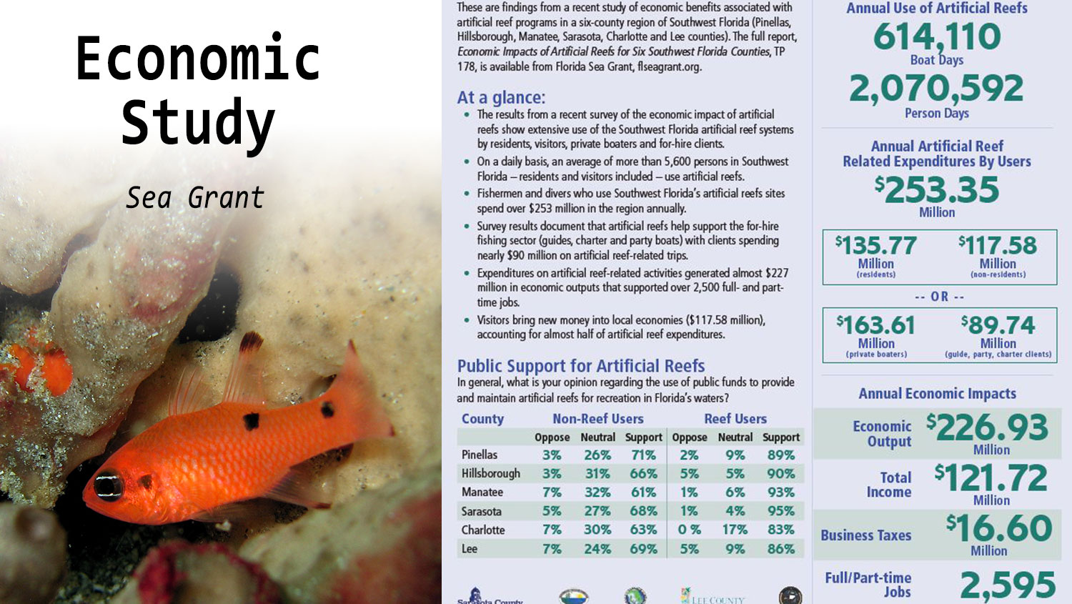

Slide 6
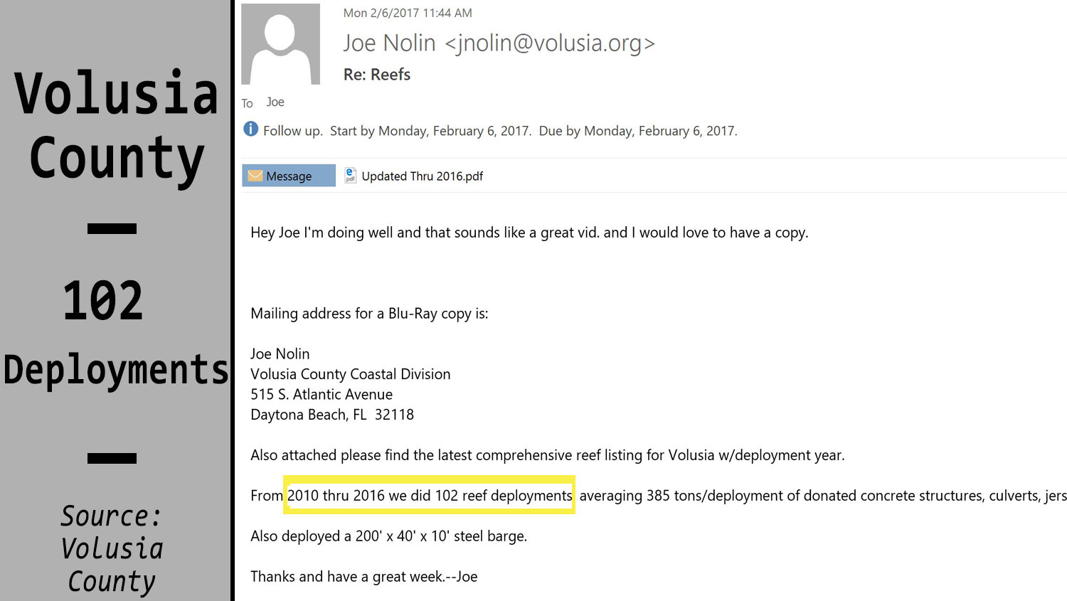

Slide 7
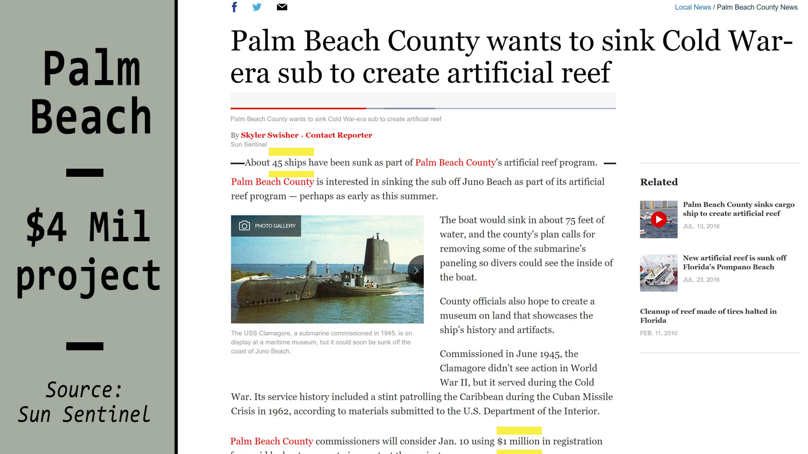

Slide 8
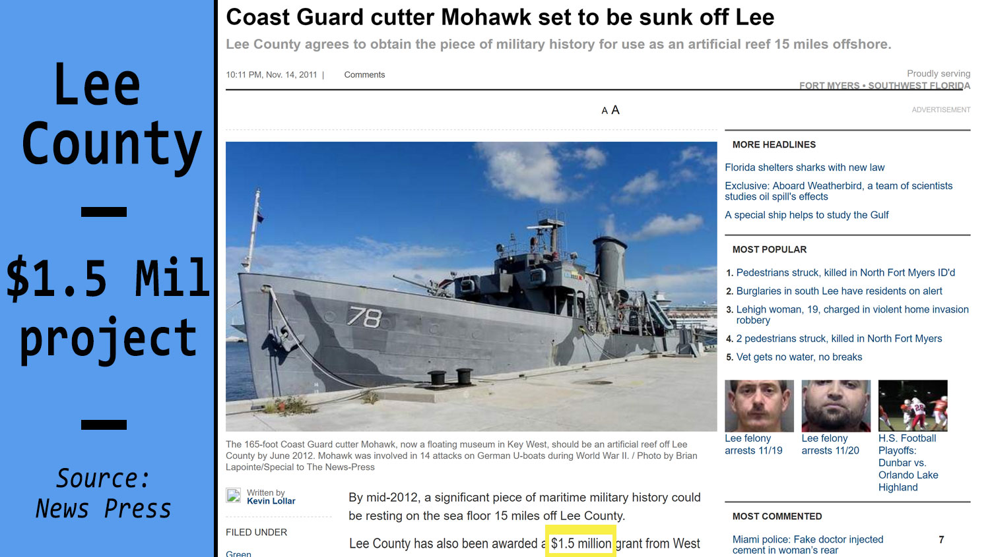

Slide 9
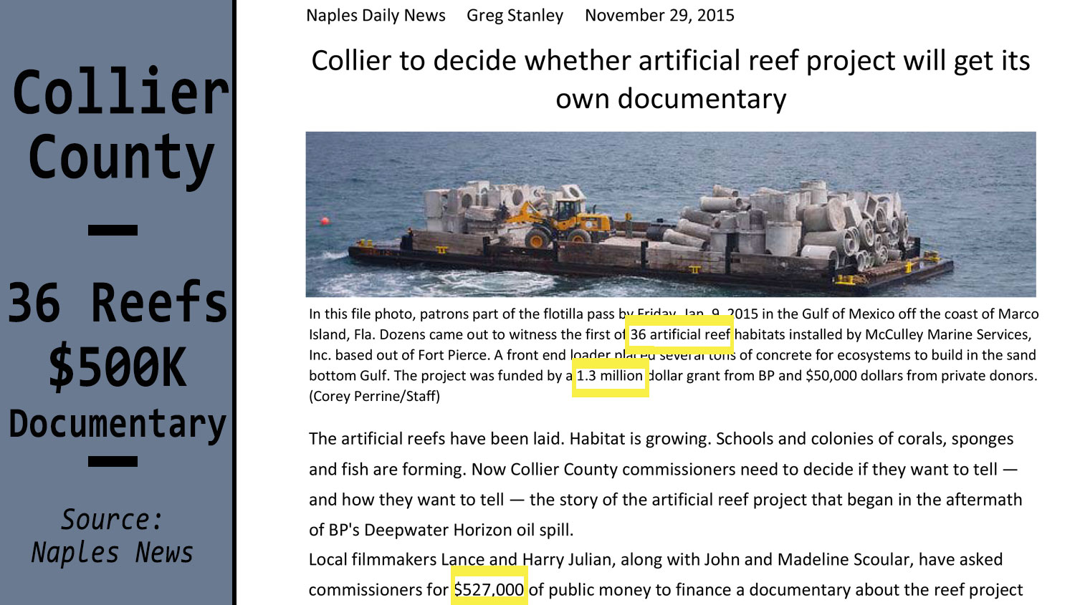

Slide 10

What do these other counties have in common?
What this means for Jacksonville
What Jacksonville can do…
1. Awareness Campaign
2. City/County Involvement and Investment

